Slide 1
Class of 2024 Educational Development Plan EDP
Post Secondary Opportunities
Setting Goals
Exploring Careers and College

Slide 2
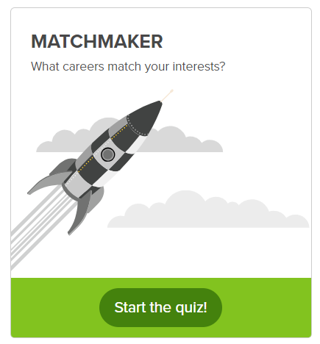
Career Matchmaker Quiz
Step 2:
Click Start the Quiz
Step 1:
Click About Me
When you have completed the Matchmaker Quiz you will see a listing of different careers that match your interest. Take time to explore these careers and save 3 career clusters.

Slide 3
Explore Careers
Save at least 3 Careers
Step 1:
Click Explore
Step 2:
Click Explore Careers

Slide 4
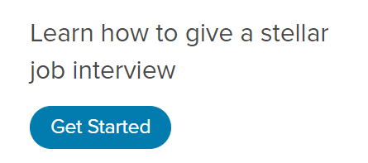
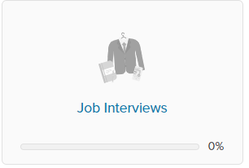
Job Interview
Step 1:
Click View all Lessons
Step 3:
Click Get Started
Step 2:
Click Job Interviews

Slide 5
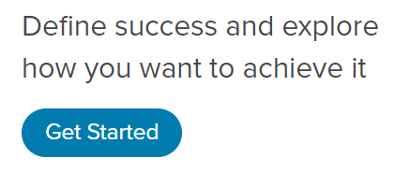
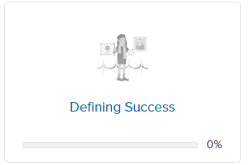
Defining Success
Step 1:
Click View all Lessons
Step 3:
Click Get Started
Step 2:
Click Defining Success

Slide 6
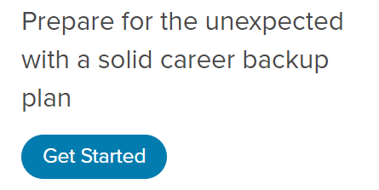
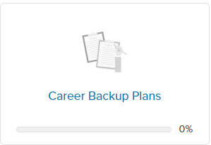
Career Backup Plans
Step 1:
Click View all Lessons
Step 3:
Click Get Started
Step 2:
Click Career Backup Plans

Slide 7
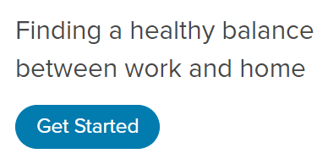
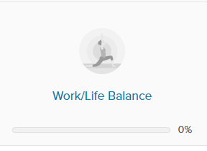
Work Life Balance
Step 1:
Click View all Lessons
Step 3:
Click Get Started
Step 2:
Click Work/Life Balance

Slide 8
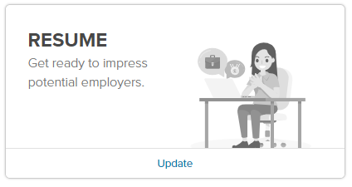
Record Experiences ~ Resume
Step 3:
Complete Each Section
Objective:
Click Add ~ Update Resume
Education:
Click Add ~ Add New ~ Update Resume
Skills:
Click Add ~ Add New ~ Update Resume
Work Experience:
Click Add ~ Add New ~ Update Resume
Volunteer Experience:
Click Add ~ Add New ~ Update Resume
Awards & Achievements:
Click Add ~ Add New ~ Update Resume
Activities & Interests:
Click Add ~ Select Saved Interests or Add New ~ Update Resume
Step 1:
Click About Me
Step 2:
Click Resume

